Slide 1
A Novel Vapor Abatement Process for Low Concentrations of Mixed Toxic Gases.
Clinton Summers, Larry Shaffer, Joe Enneking and J. Louis Kovach
NUCON International, Inc.

Slide 2
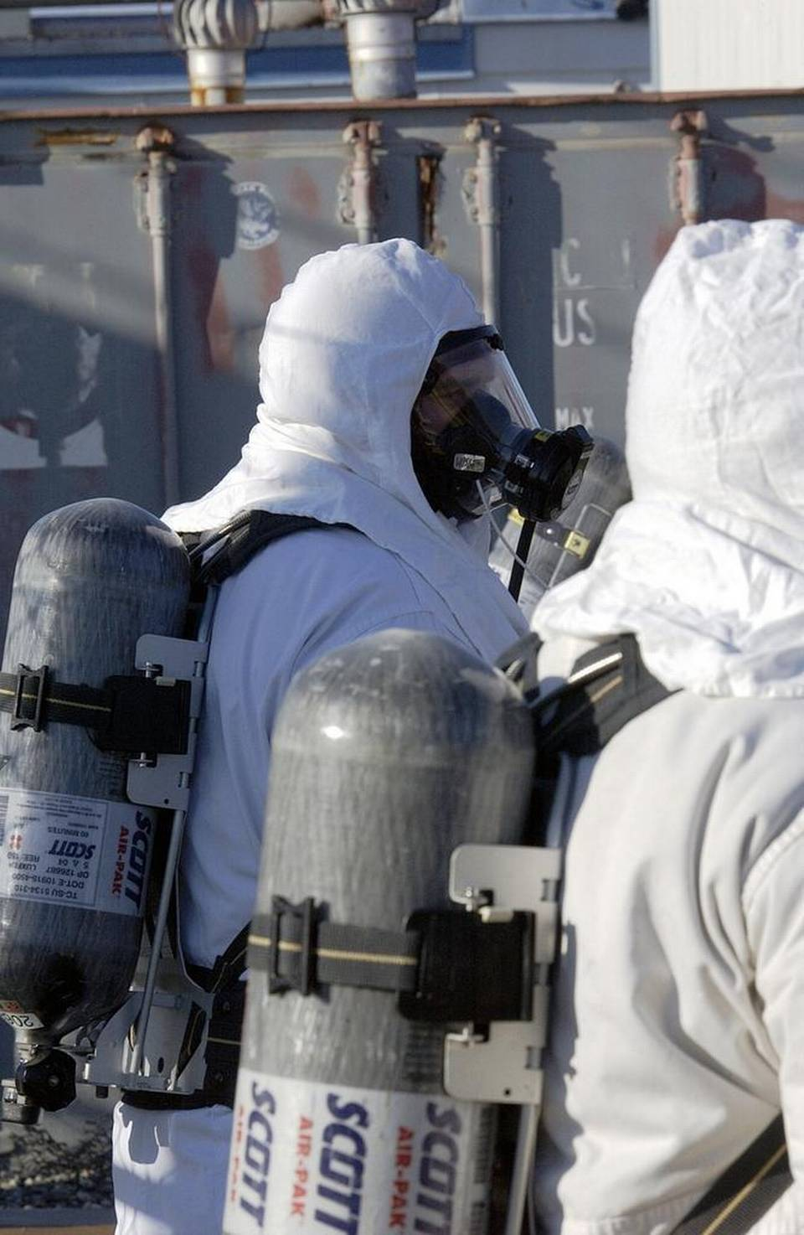
ORP Mission Need
DOE TOLD A FEDERAL JUDGE THAT USING SUPPLIED AIR RESPIRATORS TO PROTECT WORKERS FROM CHEMICAL VAPORS REDUCES EFFICIENCY BY 30 TO 70 PERCENT. Read more here: http://www.tri-cityherald.com/news/local/hanford/article84899392.html#storylink=cpy

Slide 3
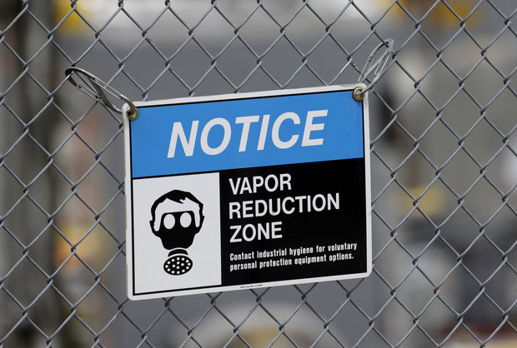
Current Headlines
More workers at Hanford report possible vapor exposure – Associated Press
Record number of Hanford workers sickened by toxic vapors – Channel 5, KING NBC affiliate
Feds will review Hanford response to toxic vapors – The Oregonian

Slide 4
Fugitive Vapor Releases
Originate from the vapors in the head space of storage tanks
May be released due to temperature / pressure differences between the interior of the tank and ambient atmosphere
May be released during any activity that disturbs tank contents

Slide 5
Fugitive Vapor Releases
Particulates
Air and water vapor
Inorganic compounds, Hg, N₂O, NH₃
Various volatile organic compounds (VOCS)
Nitroso dimethyl amine
Nitroso methyl ethyl amine
Furans
Other various organics

Slide 6
Storage Tank (Chemical Reactor)
Head space vapor layer
Liquid layer
Solids (sludge) layer
If ΔP ≈ 0 between tank head space and atmosphere, fugitive emissions ≈ 0, unless tank is disturbed
If ΔP is positive between tank head space and atmosphere, fugitive emissions > 0

Slide 7
Storage Tank
Outside Air
Air + Contaminants
Head space vapor layer
Liquid layer
Solids (sludge) layer
If ΔP is negative between tank head space and atmosphere, fugitive emissions will be 0
Influx of outside air (dilution air)

Slide 8
Abatement Options
CARBON ADSORPTION
EMISSIONS
COLLECT
EMISSIONS
CONDENSATION
OXIDIZE VOCS
THERMAL AND THERMAL CATALYTIC
Carbon adsorption – good for VOCS and Hg
Condensation – not useful at very low VOC concentrations or in the presence of water vapor
Thermal – highly efficient removal of VOCS and nitrogen compounds
DOES NOT work for Hg

Slide 9
General Process
Remove water droplets
Reduce Relative Humidity
Particulate “polishing”
HEPA Filter
Remove Hg
Combust VOCS and Nitrogen containing compounds using an internal combustion engine
Catalytically treat any
Incomplete combustion
Products
Release to stack

Slide 10
Typical Combustion Process
Most carbon is emitted as CO₂ immediately.
A small fraction emitted as non-CO₂ gases:
CH₄, CO, non-methane volatile organic compounds (NMVOCS)
Ultimately oxidizes to CO₂ in the atmosphere
Ammonia is combustible:
4NH₃(g) + 5O₂(g) ---> 4NO(g) + 6H₂O(g)
N₂O is combustible:
2N₂O(g) --->2N2(g) + O₂(g)
Notes:
The flow can be thought of as a mass balance approach to tracking carbon through the process. You first determine the amount of carbon in the fuel, and then track its fate following the combustion process.

Slide 11
Three Way Catalytic Converter
Reduction of nitrogen oxides to nitrogen and oxygen: 2NO_{x} → xO₂ + N₂
Oxidation of carbon monoxide to carbon dioxide: 2CO + O₂ → 2CO₂
Oxidation of unburnt hydrocarbons (HC) to carbon dioxide and water: C_{x}H_{(2x+2)} + [(3x+1)/2]O₂ → xCO₂ + (x+1)H₂O

Slide 12
Unit Operations
Fresh air for start-up
Intake Air
Demister
Waste Storage Tank
Trap
Induce negative ΔP
Demist air stream, collect liquid water in trap / return to waste storage tank

Slide 13
Unit Operations
To stack
Intake Air from demister
To ICE
Air/Air heat exchanger
Mersorb Bed
Hg Removal
Exhaust from ICE
HEPA
Warm up stream to be treated, heat recovered from ICE
Mercury capture in fixed adsorbent bed (< 2.5 µg/m³)

Slide 14
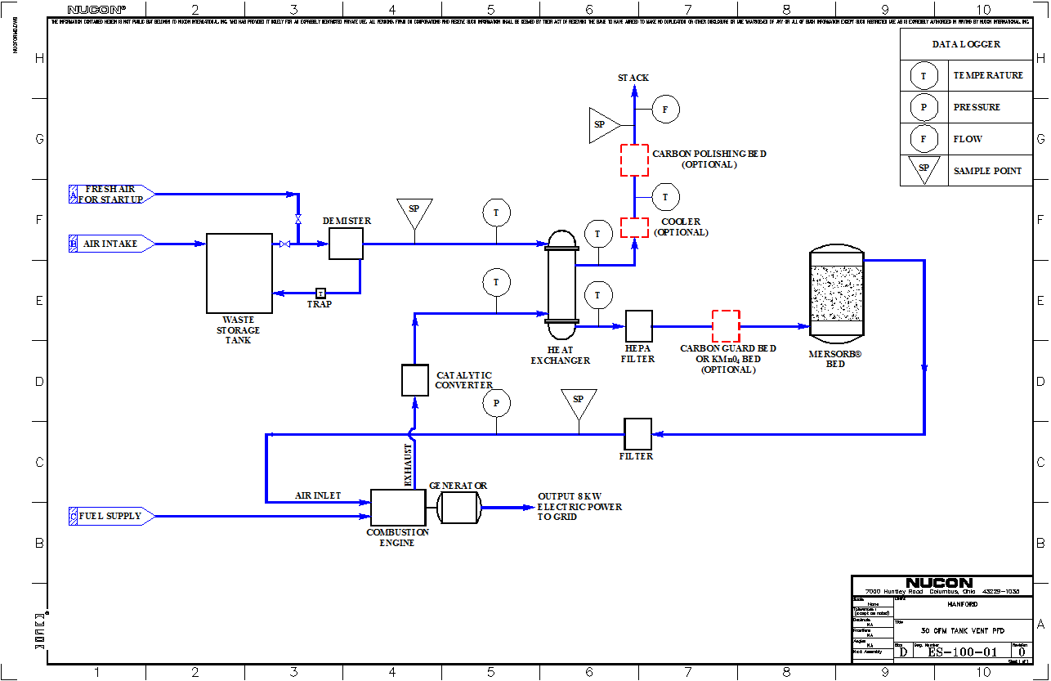

Slide 15
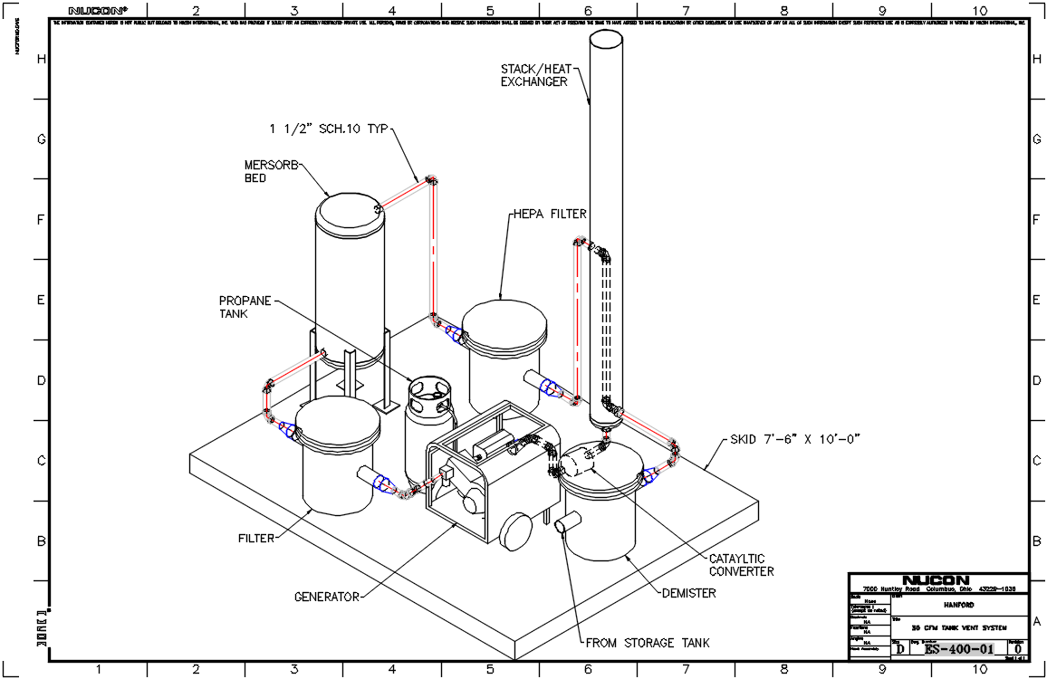

Slide 16
System Advantages
Addresses the issue of fugitive emissions by maintaining a negative ΔP relative to atmosphere, clean air enters waste storage tank as contaminated head space air is removed
Removed head space air is treated to address all major contaminant issues; Hg, N₂O, NH₃ and VOCS using a proven technology
Optional “treatment nodes” to address future concerns
Economically viable, and at lower cost than other alternatives

Slide 17
Operational Parameters
Gas temperature range
Inlet to system: 57 to 115° F
Mercury adsorbent bed inlet: ≈ 150° F
ICE exhaust: 1200° F
Exhaust to stack can be controlled if required
Mass flow range
Demonstration unit: ≈ 30 SCFM
Installed equipment: 30 to 2000 SCFM
Demonstration unit footprint
7.5 x 10 ft

Slide 18
Experimental Description
Process flow will be measured
Flow of contaminants will be set to pre-determined levels
Contaminant levels will be measured at process inlet
IRPAD – organics, ammonia, nitrous oxide
Lumex – mercury
Contaminant levels will be measured at process points down stream of adsorber and internal combustion engine outlets

Slide 19
Experimental Set-up
Q ≈ 30 CFM
To process
Organic
solution
Hg
NH₃
N₂O

Slide 20
Test Vapor Composition
Chemical Name | Target Inlet Concentration | Detection Method
Nitrous Oxide | ≈1000 ppm | IR-PAD
Ammonia | ≈ 400 ppm | IR-PAD
Mercury | ≈1000 µg/m | Lumex 915+
Formaldehyde | ≈10 ppm | IR-PAD
Hexanes^{A} | ≈ 200 ppm | IR-PAD
Furan^{A} | ≈ 200 ppm | IR-PAD
2,3-dihydrofuran^{A} | ≈ 200 ppm | IR-PAD
2-furan carboxy aldehyde^{A} | ≈ 200 ppm | IR-PAD
Pyridine^{A} | ≈ 200 ppm | IR-PAD
Nitroso-dimethylamine^{B} | ≈ 92 µg/L | IR-PAD

Slide 21
General Testing Process
Vapor Abatement Unit started and air flow through the system allowed to stabilize.
Exhaust backgrounds measured for at least 5 measurement cycles.
Inlet backgrounds measured for at least 5 measurement cycles.
Injection of challenge agent started, inlet concentration monitored until concentration stabilized.
Exhaust concentrations checked and monitored for at least 5 measurement cycles.
Injection stopped.
Vapor Abatement Unit allowed to “clear” for three to five minutes, then shut down.

Slide 22
Challenge Agent | Average Inlet Concentration (ppm) | Average Exhaust Concentration (ppm) | Remaining Challenge Agent Concentration (%) | Destruction Efficiency (%)
Ammonia | 424.08 | 7.74 | 1.83 | 98.17
Nitrous Oxide – Test 1 | 888.4 | 0.08 | 0.01 | 99.99
Nitrous Oxide – Test 2 | 1440.73 | 0 | 0 | 100
Formaldehyde – Test 1 | 4.27 | 0 | 0 | 100
Formaldehyde – Test 2 | 14.19 | 0 | 0 | 100
Organics Mixture | 304.89 | 14.55 | 4.77 | 95.23
NDMA^{B} | 10.71 | 0 | 0 | 100
Mercury^{C} | 2247^{C} µg/m³ | 0 | 0 | 100

